Slide 1
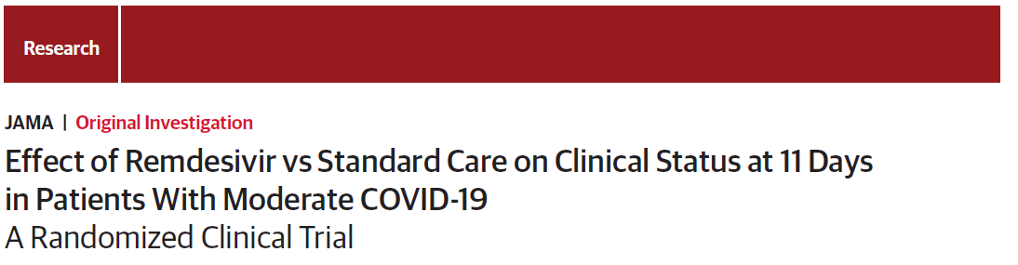
JAMA. 2020;324(11):1048-1057. doi:10.1001/jama.2020.16349
Published online August 21, 2020.

Slide 2
Introduction
In the first 6 months of the pandemic, severe acute respiratory syndrome coronavirus 2 (SARS-CoV-2) has spread worldwide and has infected nearly 20 million people.
Many infected people are asymptomatic or experience mild symptoms.

Slide 3
Remdesivir is a nucleotide prodrug whose active metabolite inhibits viral RNA-dependent RNA polymerases, structurally conserved enzymes that play a key role in the replication of a broad range of viruses.
This randomized, open-label, multicenter study was conducted to evaluate the efficacy and adverse events of remdesivir administered for 5 or 10 days vs standard care in hospitalized patients with moderate COVID-19

Slide 4
Methods
Hospitalized patients with SARS-CoV-2 infection confirmed by polymerase chain reaction assay within 4 days of randomization and moderate COVID-19 pneumonia (defined as any radiographic evidence of pulmonary infiltrates and oxygen saturation >94% on room air) were enrolled.

Slide 5
Exclution criteria
Patients with alanine aminotransferase or aspartate aminotransferase greater than 5 times the upper limit of normal or creatinine clearance of less than 50 mL/min were excluded

Slide 6
All patients randomized to a remdesivir group received 200mg of remdesivir intravenously on day 1, followed by 100 mg of remdesivir once daily for the subsequent days, infused over 30 to 60 minutes.

Slide 7
primary end point
the proportion of patients discharged by day 14 of the study
This was amended to assessment of clinical status on a 7-point ordinal scale by day 11
Patient assessments included physical examination, respiratory status (respiratory rate, type of oxygen supplementation, blood oxygen saturation, and radiographic findings), adverse events, and concomitant medications. On study days 1,3, 5, 8, 10, and 14, blood samples were obtained for measurement of blood cell counts, serum creatinine, glucose, total bilirubin, and liver transaminases.

Slide 8
secondary end point
the proportion of patients with adverse events throughout the duration of the study.
duration of hospitalization
duration of different modes of respiratory
all-cause mortality

Slide 9
Prespecified Exploratory end points
Time to recovery
Time to clinical improvement
Time to discontinuation of any oxygen support

Slide 10
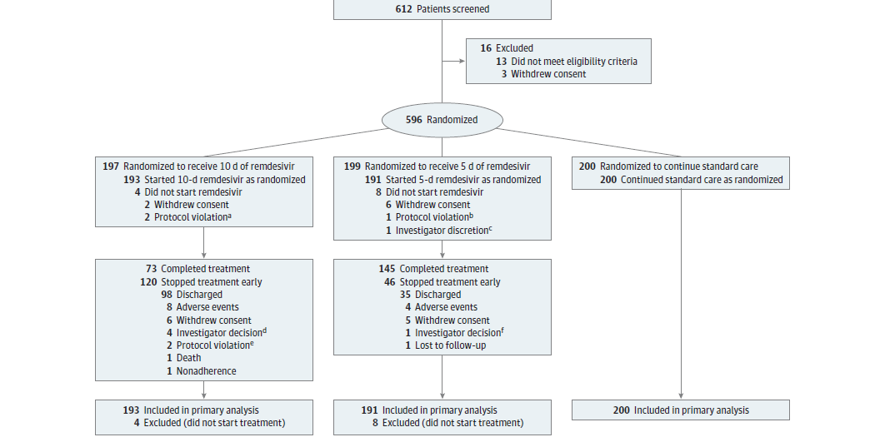

Slide 11
Result

Slide 12
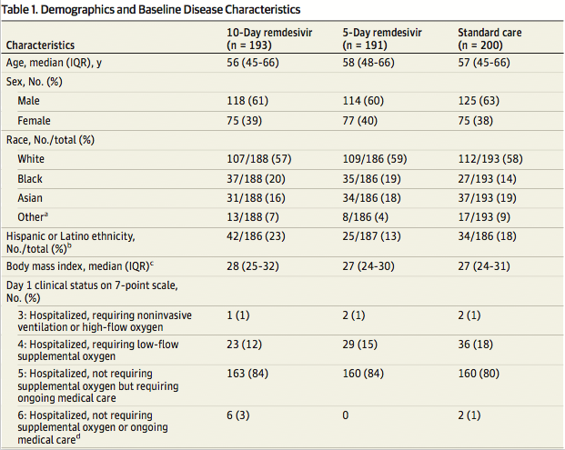

Slide 13
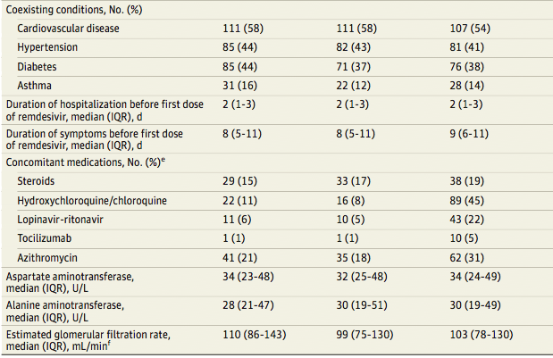

Slide 14
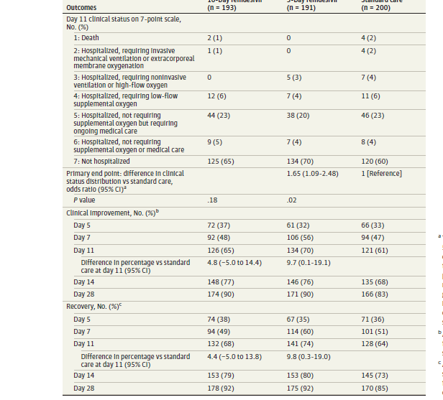
Results

Slide 15
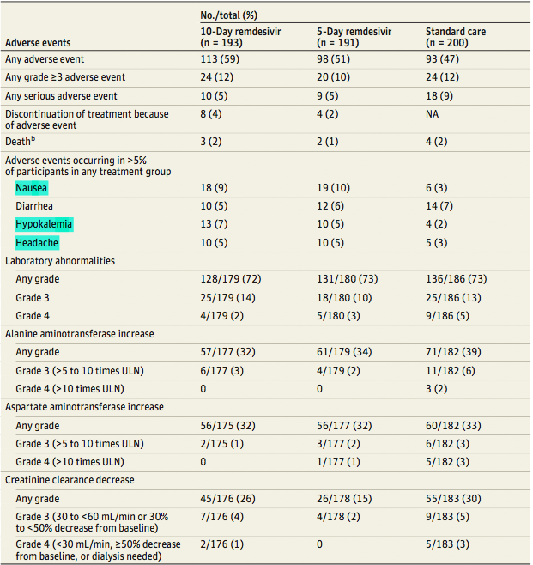

Slide 16
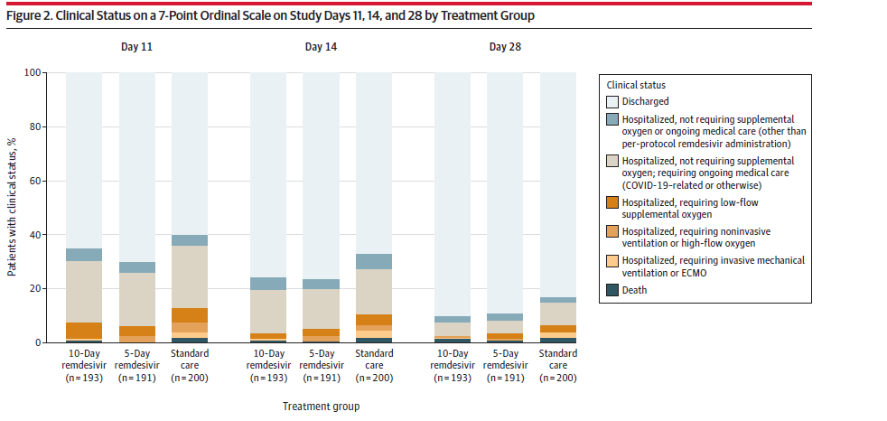

Slide 17
Discussion
In this clinical trial of patients with moderateCOVID-19 pneumonia, those who were randomized to remdesivir treatment for up to 5 days had significantly higher odds of having a better clinical status distribution on day 11 than those receiving standard care, but with an effect size of uncertain clinical importance. The difference in the distribution of clinical status on day 11 between the 10-day remdesivir and standard care groups was not significant.

Slide 18
Limitations
the original protocol was written when COVID-19 cases were largely confined to Asia and the clinical understanding of disease was limited to case series.
the study used an open-label design, which potentially led to biases in patient care and reporting of data.
because of the urgent circumstances in which the study was conducted, virologic outcomes such as effect of remdesivir on SARS-CoV-2 viral load were not assessed.
other laboratory parameters that may have aided in identifying additional predictors of outcomes were not routinely collected.
the ordinal scale used to evaluate outcomes was not ideal for detecting differences in patients with moderate COVID-19, especially for a clinical situation in which discharge decisions may be driven by factors other than clinical improvement

Slide 19
Conclusions
Among patients with moderate COVID-19, those randomized to a 10-day course of remdesivir did not have a statistically significant difference in clinical status compared with standard care at 11 days after initiation of treatment. Patients randomized to a 5-day course of remdesivir had a statistically significant difference in clinical status comparedwith standard care, but the difference was of uncertain clinical importance.

Slide 20
