Slide 1

COVID-19
Here is where your presentation begins

Slide 2

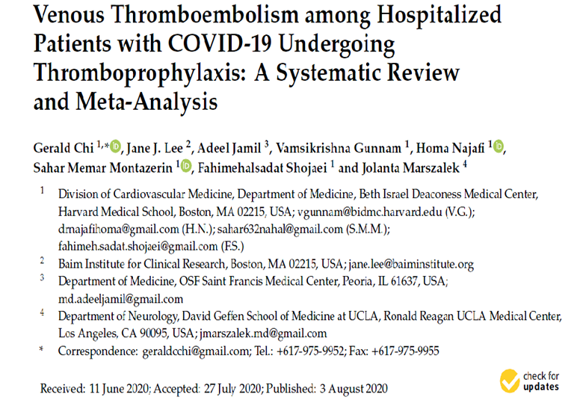

Slide 3
Introduction

Slide 4
Patients with coronavirus disease 2019 infection may present with adiverse clinical spectrum, ranging from asymptomatic carriage, mild respiratory or gastrointestinal symptoms, to severe pneumonia and multi-organ failure.
In some cases, COVID-19 infection may be associated with abnormalities in coagulation parameters.

Slide 5
the study aimed to synthesize the current evidence on the incidence of VTE among COVID-19 patients undergoing thromboprophylaxis in the ICU or ward setting, and to examine the potential prognostic value of the D-dimer measurement.

Slide 6
Methods

Slide 7
This study was Systematic Reviews and Meta-Analyses in PubMed, All searches were limited to the English language and the time from inception to 31 May 2020.

Slide 8
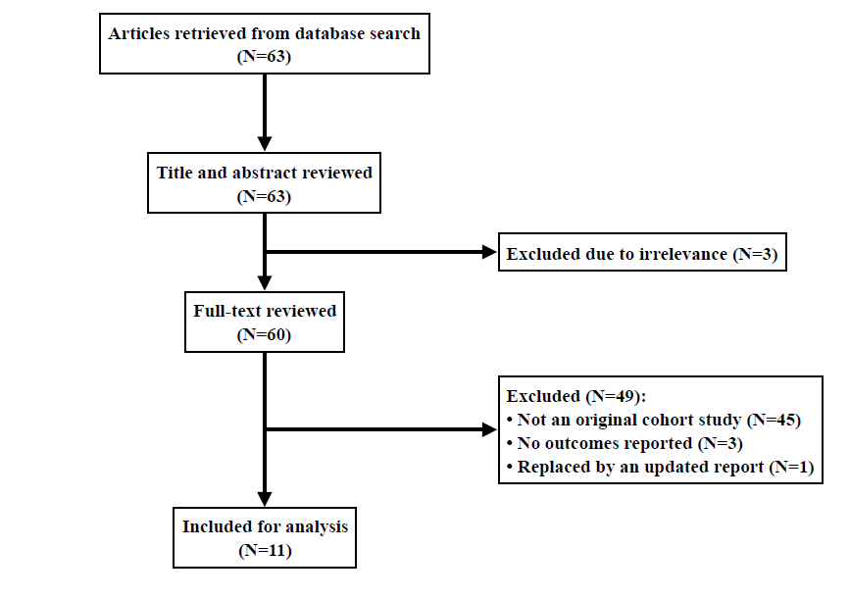

Slide 9
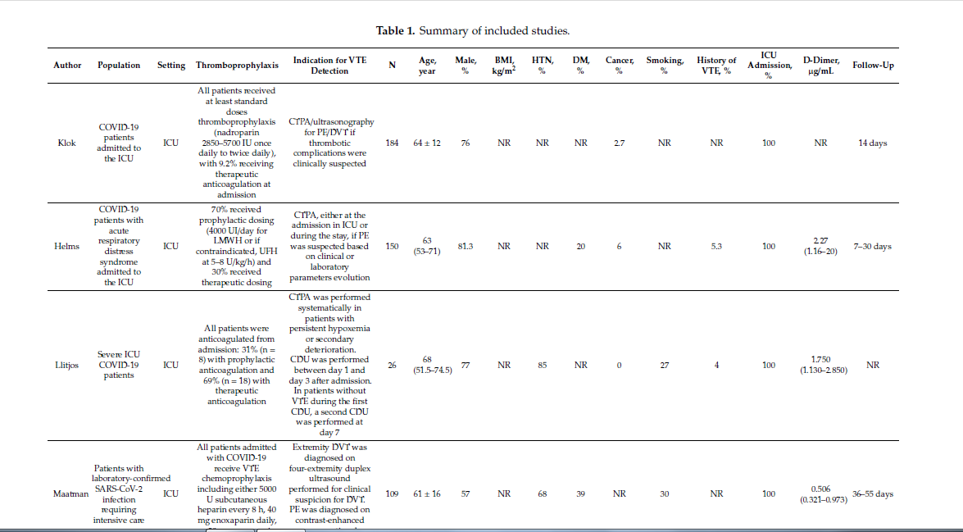

Slide 10
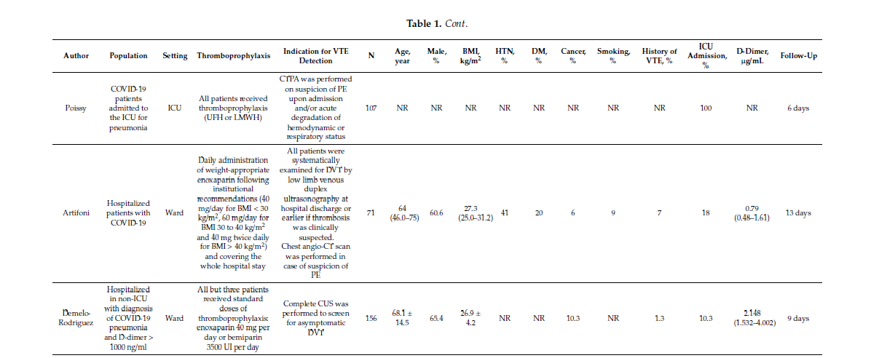

Slide 11
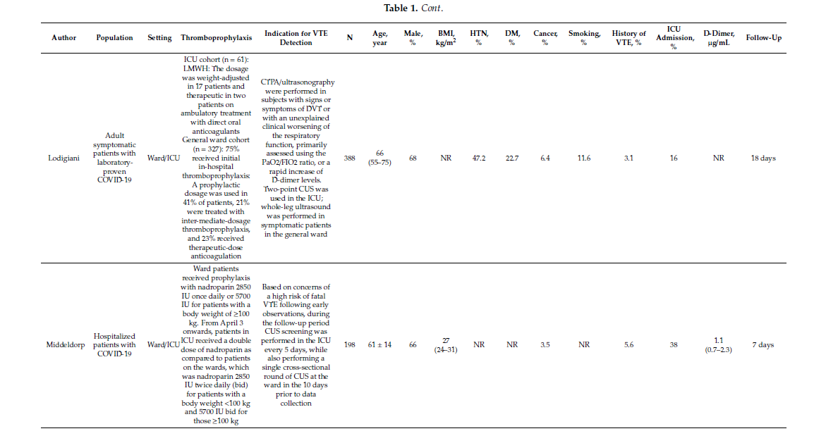

Slide 12
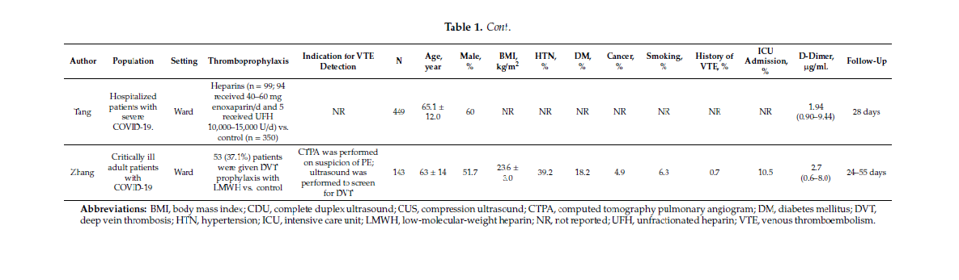

Slide 13
endpoints :VTE, PE, deep vein thrombosis (DVT), or mortality among hospitalized patients with COVID-19
infection who received at least standard doses of thromboprophylaxis with UFH or LMWH.

Slide 14
Result

Slide 15
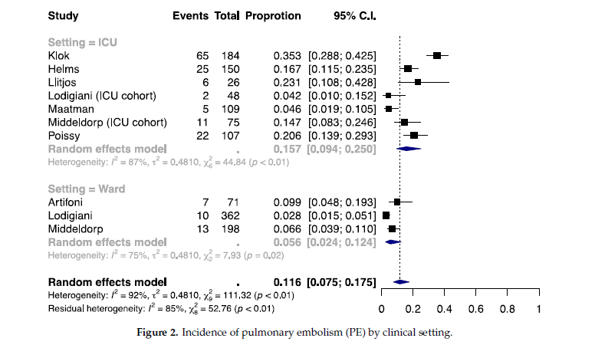

Slide 16
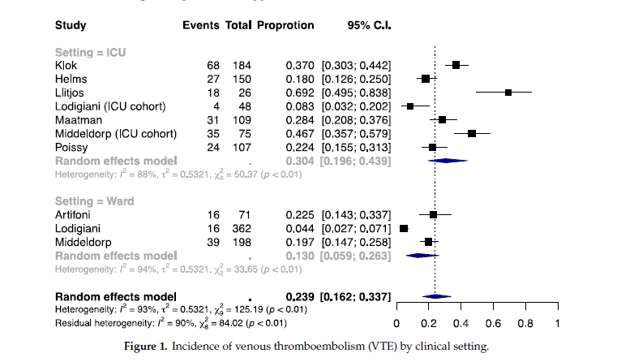

Slide 17
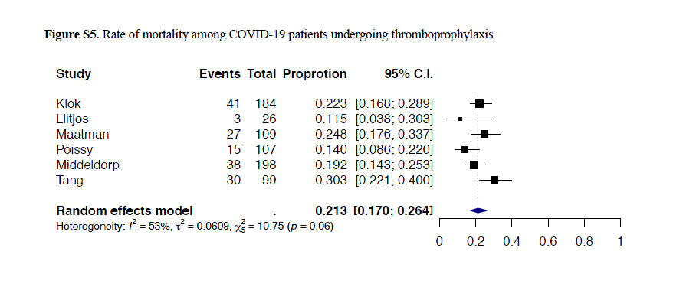

Slide 18
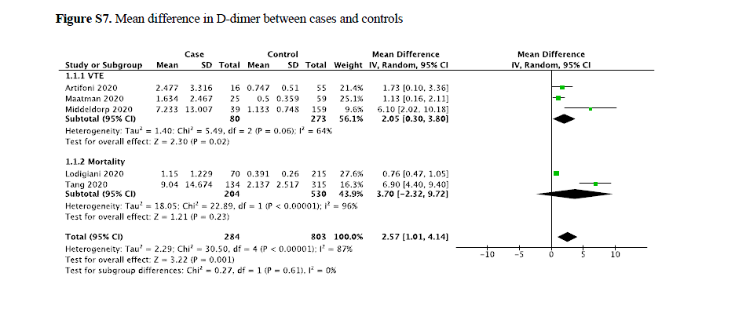

Slide 19
Discussion

Slide 20
Based on aggregate data from cohort studies, Overall, approximately 24% developed VTE (12% developed PE and 12% developed DVT) despite anticoagulation with at least prophylactic dosing.
The risks of VTE and PE were both higher in the ICU setting (30% and 16%) than in the ward setting (13% and 6%). In contrast, the risk of DVT
was similar in the two settings.

Slide 21
In a multicenter cohort study of adult inpatients with COVID-19,
a D-dimer > 1.0 g/mL was associated with 18-fold increased odds for in-hospital death, while the association was not significant with >0.5 g/mL.
40 mg twice daily,
especially for BMI > 30 kg/m2) by institutional antithrombotic protocols..

Slide 22
Limitations
First: information about the comparative eficacy and safety of thromboprophylaxis was unavailable.
Second:most of the included studies were retrospective.
Third: the decision to perform computed tomography pulmonary angiography or ultrasonography was at the discretion of the treating physicians, and ascertainment bias cannot be excluded.

Slide 23
Limitations
Fourth: the majority of the included studies evaluated the incidence of VTE events that occurred during hospital stay and followed the patients for a relatively short duration.

Slide 24
Conclusions
The heightened risk of VTE in COVID-19 despite prophylactic anticoagulation calls for research on the pathogenesis of thromboembolic complications. Marked elevation of D-dimer levels may be associated with VTE development and can be used to identify high-risk subsets.

Slide 25
THANKS!

Slide 26
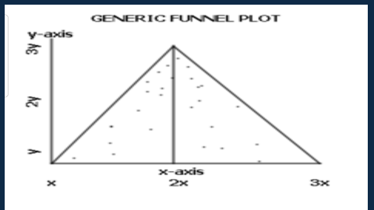

Slide 27
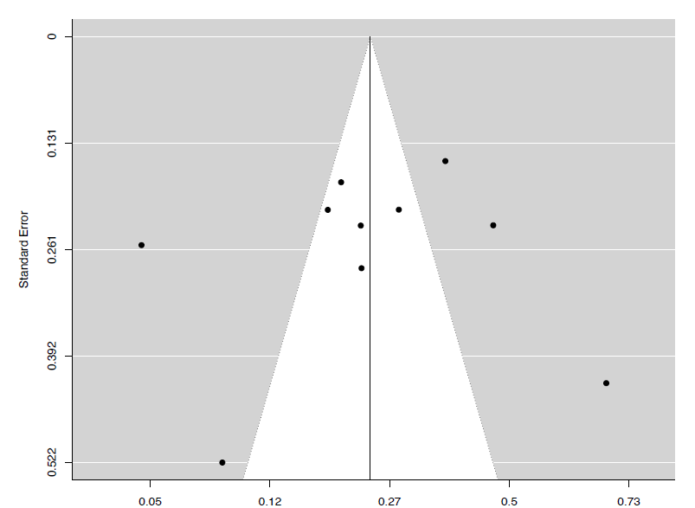

Slide 28
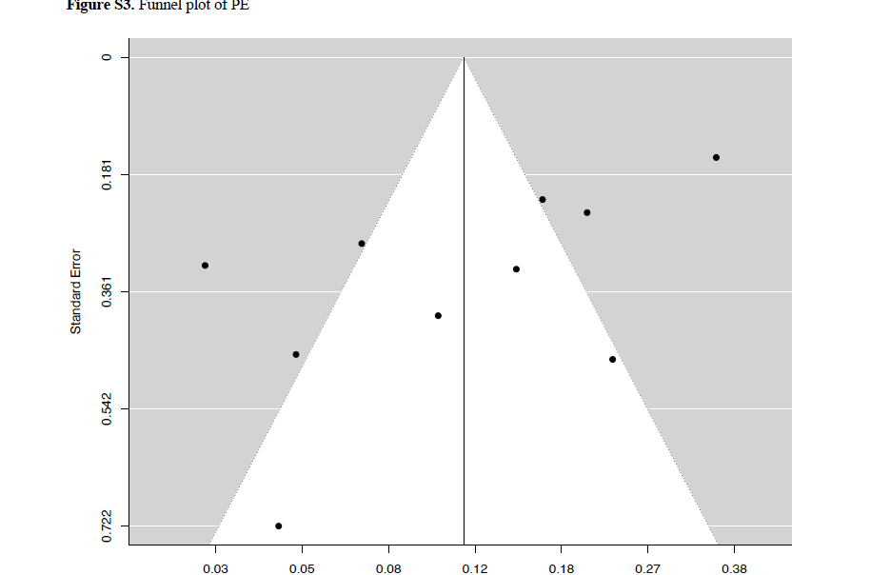

Slide 29
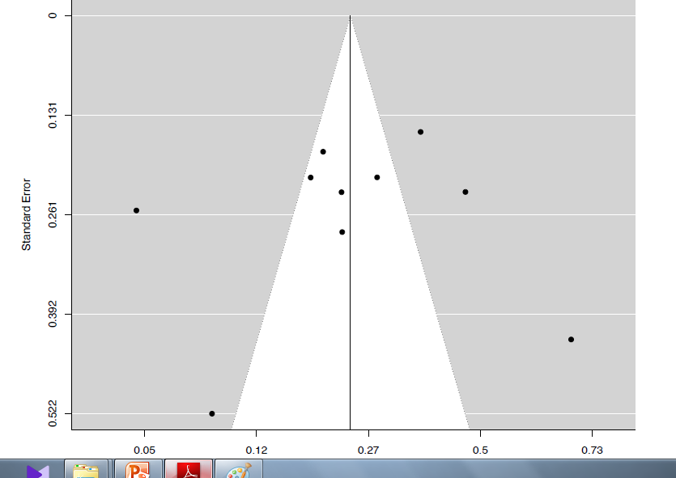

Slide 30
