Slide 1
Case presentation

Slide 2
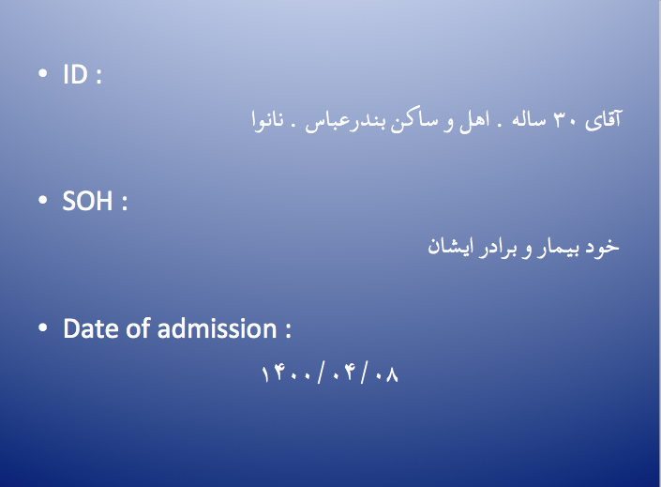

Slide 3
CC
سرفه پروداکتیو و تنگی نفس

Slide 4
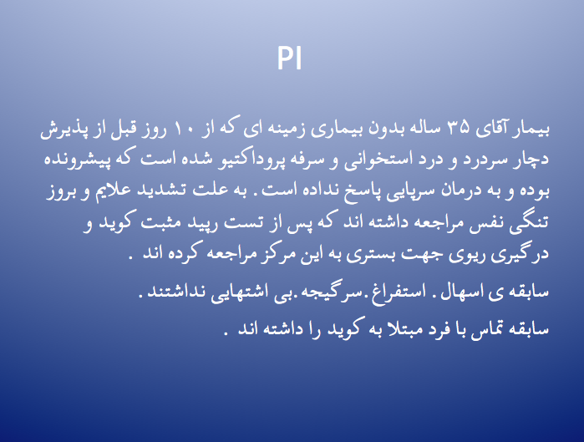

Slide 5
PMH : negative
SH : methadone . Tobacco
AH : negative
FH : covid PCR +
DH : HCQ . Diphenhydramine.Acetaminophen

Slide 6
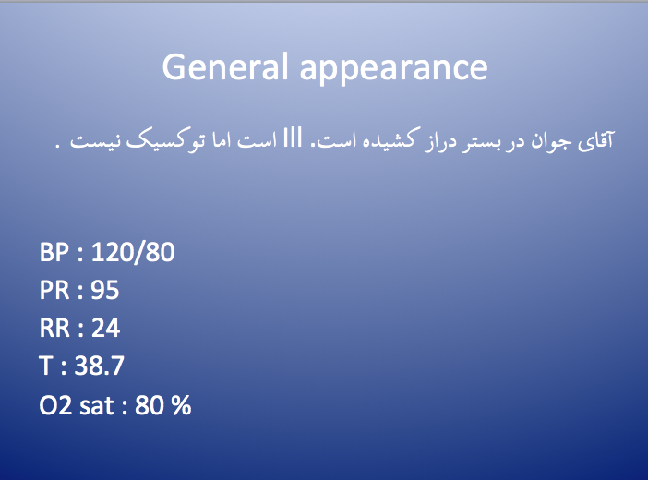

Slide 7
Pale –
Icteric –
JVP : flat
LAP –
Heart : S1 & S2
Lung : generalized coarse crackles and wheezing
Intercostal retraction –
Abdomen : soft . Without organomegaly . Without tenderness

Slide 8
Extremities :
  Edema –
  Cianosis –
  Clubbing -

Slide 9
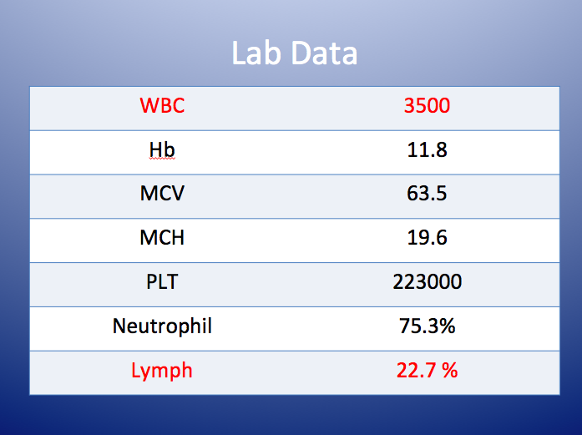

Slide 10
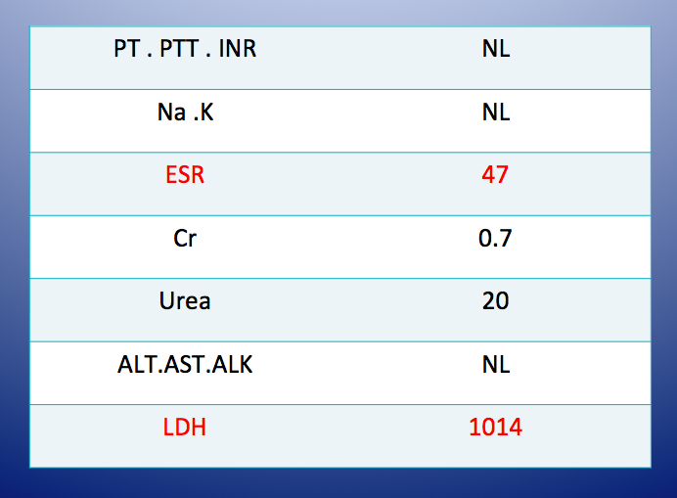

Slide 11
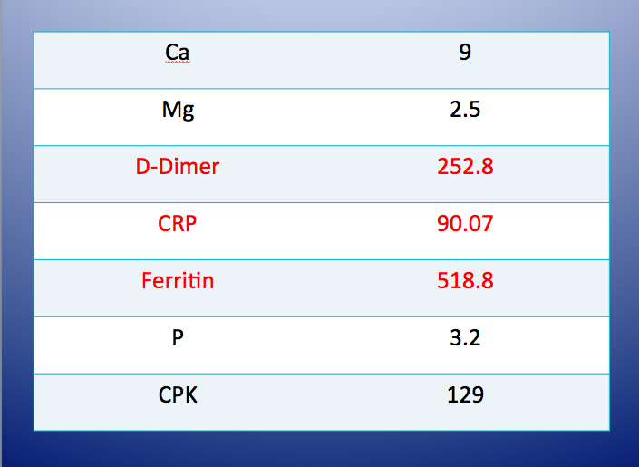

Slide 12
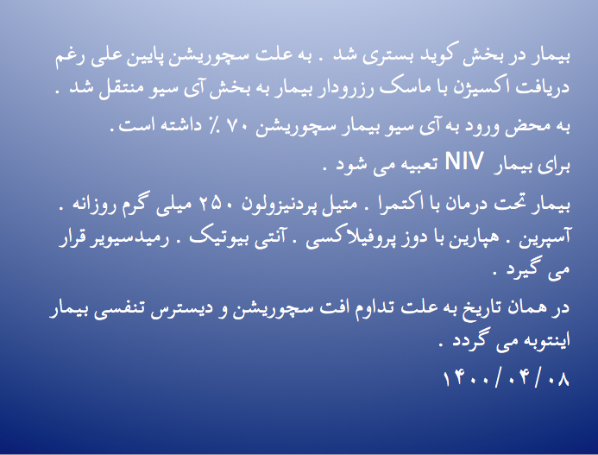

Slide 13
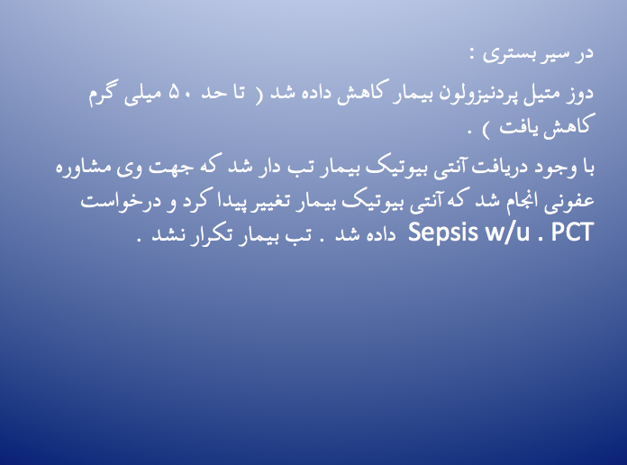

Slide 14
B/C *2 | Negative
U/C | Negative
PCT | 0.4

Slide 15
Throat culture
Acinetobacter :
-Sensitive : ceftazidime
-Resistance : amikacin . Ampicillin/sulbactam . Cefepime.co-trimoxazole.doxycyclin.imipenem
Klebsiella :
-sensitive : amikacin . Imipenem
-Resistance : ampicillin/sulbactam.cefepime.ceftazidime.co-trimoxazole

Slide 16
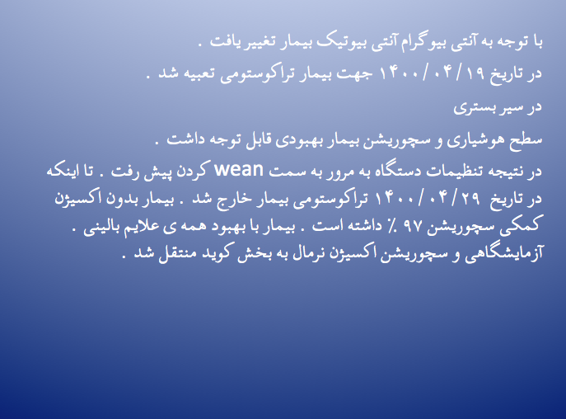

Slide 17
CPAP. T-piece
T-piece
DC

Slide 18
ESR : 47➔30➔5➔2➔1
D-dimer : 252.8➔2229➔826.6➔52.8
CRP : 90.7➔59➔10➔3.05➔.. ➔1.01
LDH : 1014➔1277➔2291➔1806➔…➔638

Slide 19
